Slide 1

Name : Smit Pansuriya
Enrollment No : 21010101138
Class : C-332
Forward
Biasing

Slide 2

What is Forward Bias?
Forward bias or biasing is where the external voltage is delivered across the P-N junction diode.
In a forward bias setup, the P-side of the diode is attached to the positive terminal and N-side is fixed to the negative side of the battery.
Here, the applied voltage is opposite to the junction barrier potential.
Due to this, effective potential barrier and junction width decrease which further results in more majority of carriers flowing across the junction.

Slide 3
The amount of voltage required is also less for the complete elimination of the barrier.
Forward biased PN junction forces the majority charge carriers to move across the junction.
Due to this reason, there is a decrease in the width of the depletion layer.
The number of holes and electrons are combined with each other once the junction is crossed.

Slide 4
Each hole in P side combines with an electron that is from the N side. Due to this reason, a covalent bond will break and an electron generated from the covalent bond move towards the positive terminal.
There is a formation of electron-hole pair.
Holes carry current in the P region.
Electrons carry current in the N region.

Slide 5
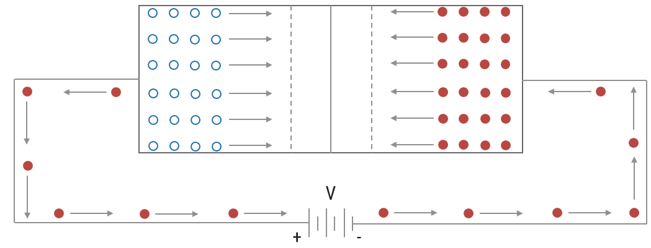
Depletion region
Si = 0.7 V
Ge = 0.3 V
P
N

Slide 6
When the junction is forward biased, we can say that :
In the case of silicon, the barrier is reduced and is eliminated altogether at a forward voltage of 0.7 V.
The junction offers low resistance, known as forward resistance r_{f}, to current flow.
Current flows in the circuit due to establishment of low resistance path and the magnitude of current depends upon the magnitude of applied forward voltage.

Slide 7
Characteristics of Forward Biasing
Inside the junction diode, current flow is by both majority carriers; but in an external circuit, current flow is by electrons only.
Current flow in forward bias of the order of flow mA.
If the applied voltage is increased temperature also increases.
The graph of the current versus applied voltage does not give a straight line.

Slide 8
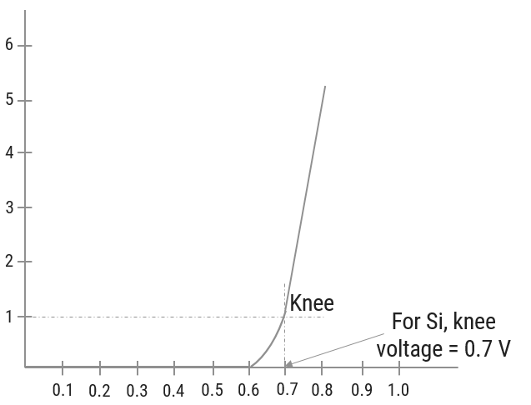
Forward current in mA
Forward bias in Valts

Slide 9
The width of the depletion region of the diode progressively decreases with forwarding biasing.

Slide 10
Thank You

